Slide 1

BASH
BASICS

Slide 2

What’s Shell?
An interface between a user and an operating system. We can access shell using a Terminal
What’s Bash?
Bash is the most popularly used shell, and is the command line language for most Unix/Linux-based OS.

Slide 3

Why use Bash?
Bash is far more flexible than cmd. It enables user to access Unix/Linux commands and software.
How to use Bash in other OS?

Slide 4

Why use Bash?
Bash is far more flexible than cmd. It enables user to access Unix/Linux commands and software.
Some basic Bash Commands...
How to use Bash in other OS?

Slide 6
SHELL
SCRIPTING

Slide 7
What?
Shell Scripting is making a program to write a series of commands for the shell to execute
Why?
It combines lengthy and repetitive sequences of commands that can be stored and executed anytime which, reduces programming efforts

Slide 8
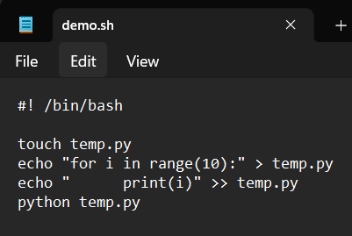
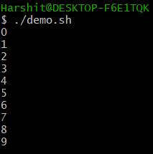
How?
Open your favorite text editor...
Note the extension of file
Run the script in the shell terminal
./filename
Line to be added in the
beginning of every script
Commands to be executed
Commands
executed

Slide 9
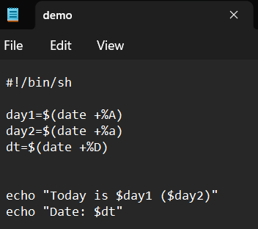
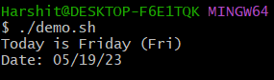
Shell Variables
Declare variables as name=value Note: there must be no space on either side of ‘=’
$ is used to access the value of a variable, expression or a command

Slide 10
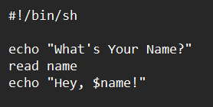

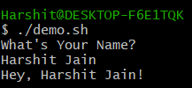
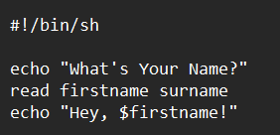

Read Input
The input is split at <space> & <tab> according to no. of variables declared
Take input using command: read variable

Slide 11
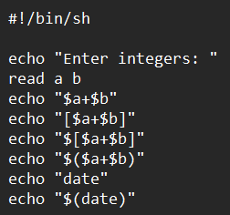
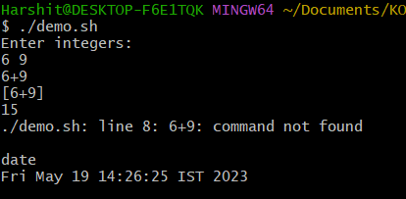
Evaluate Expressions & Commands
To evaluate expressions:
$[expression]
To evaluate commands:
$(command)

Slide 12
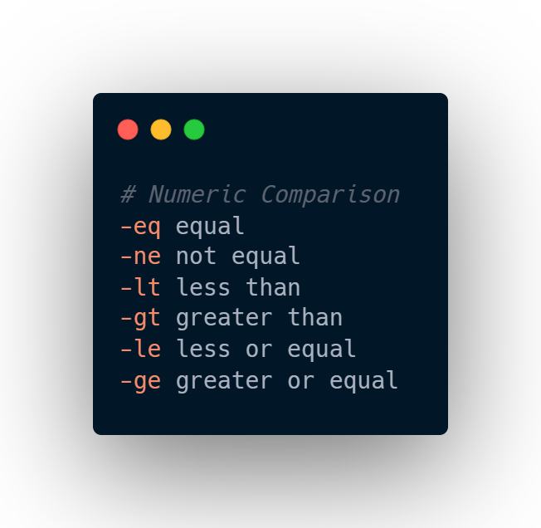
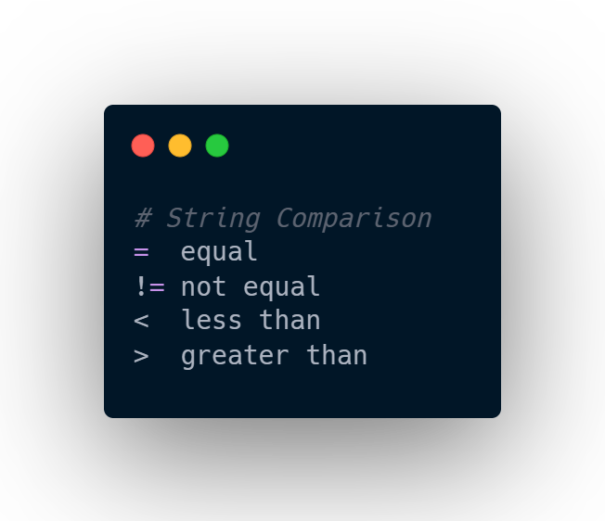
Some Comparison Operators

Slide 13
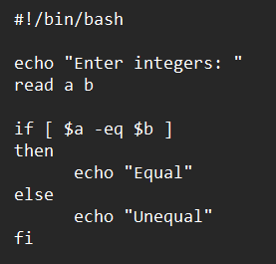
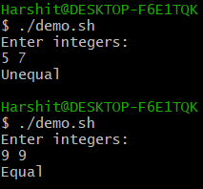
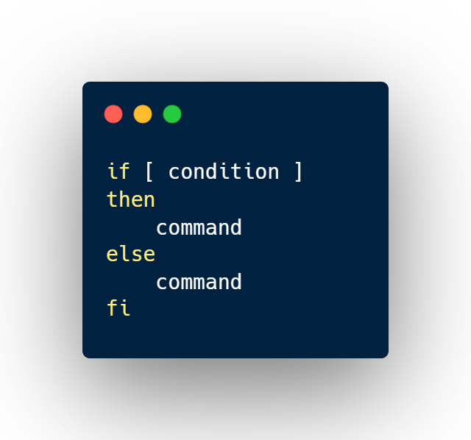
If-Else Statements

Slide 14
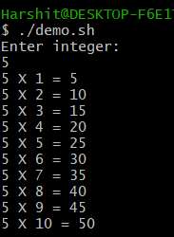
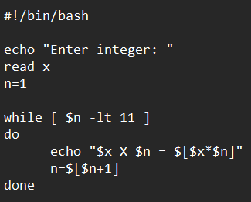
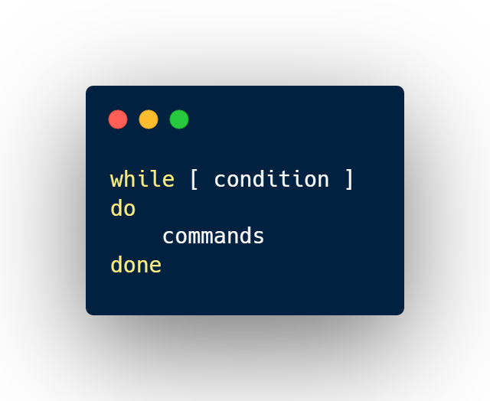
While Loops

Slide 15
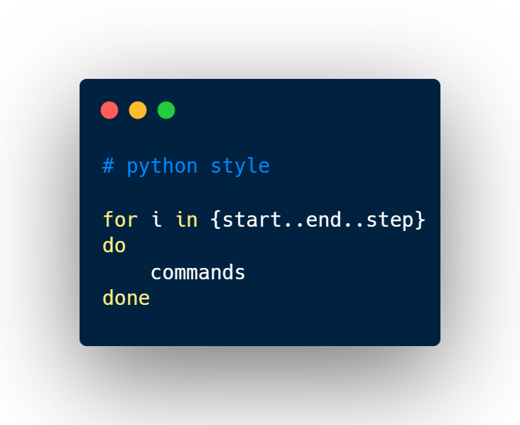
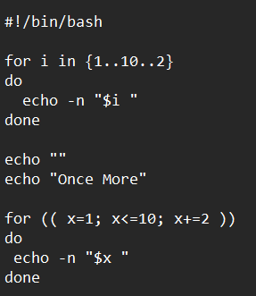

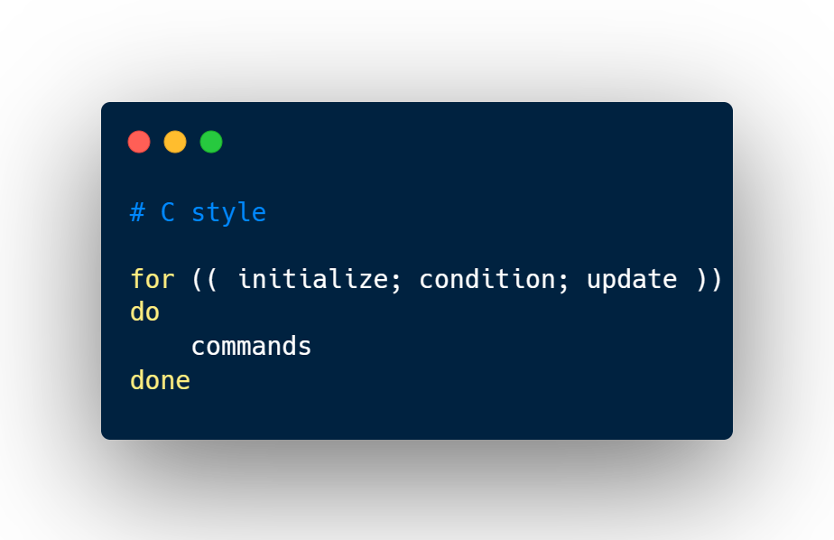
For Loops
flag to print output of next echo in the same line

Slide 16
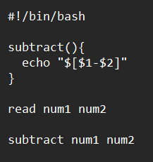
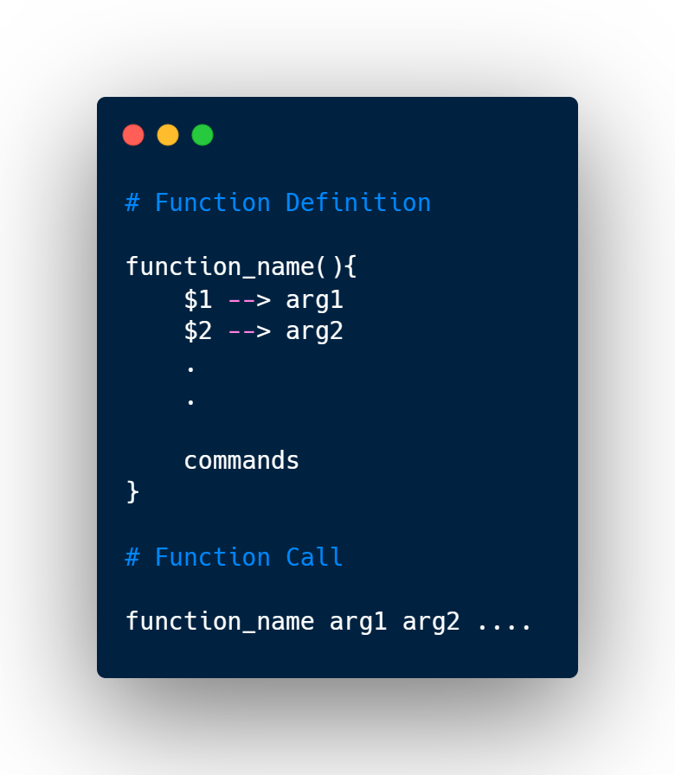
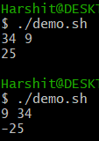
Functions

Slide 17
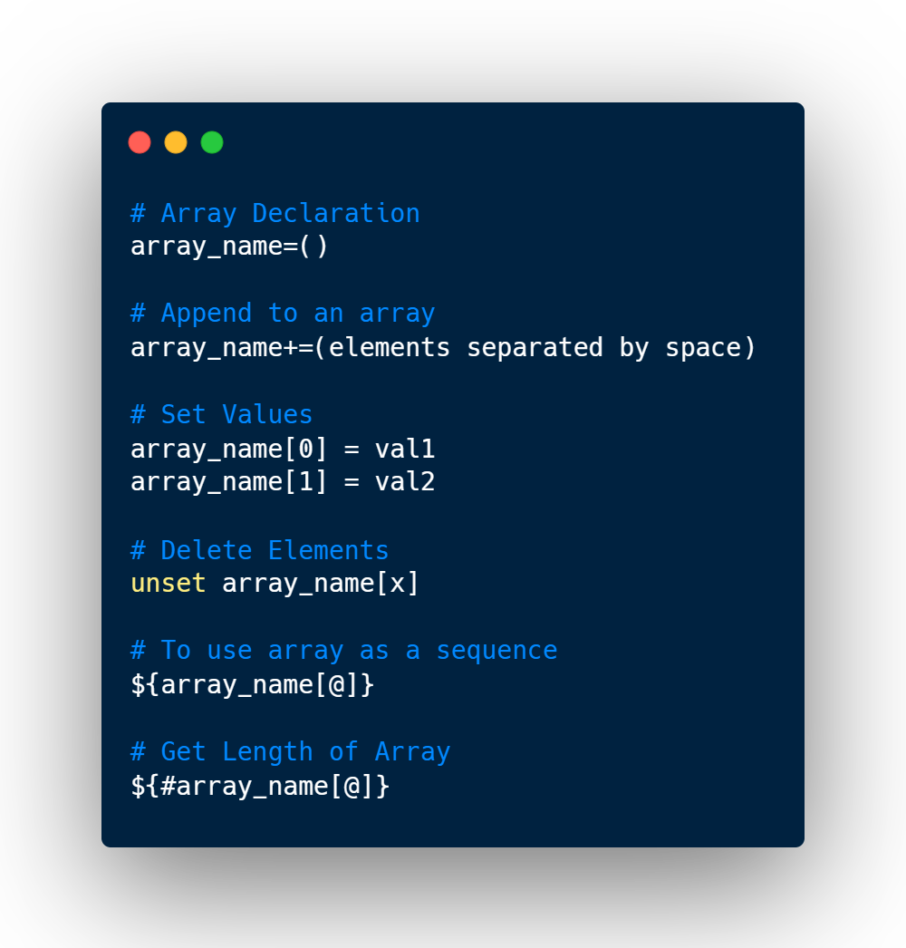
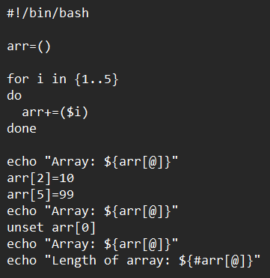
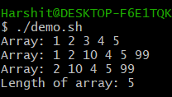
Bash Arrays

Slide 18
Bash Arrays
Moving on to utilize Shell Scripting to read data from CSV files through Bash Terminal...

Slide 19
PARSING
CSV
FILES

Slide 20
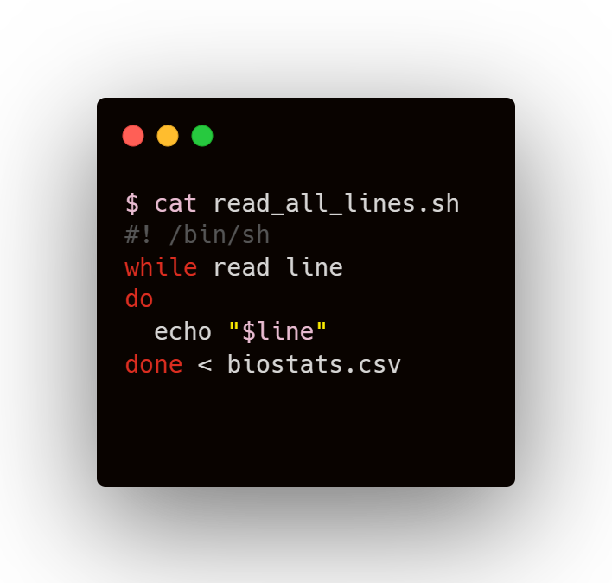
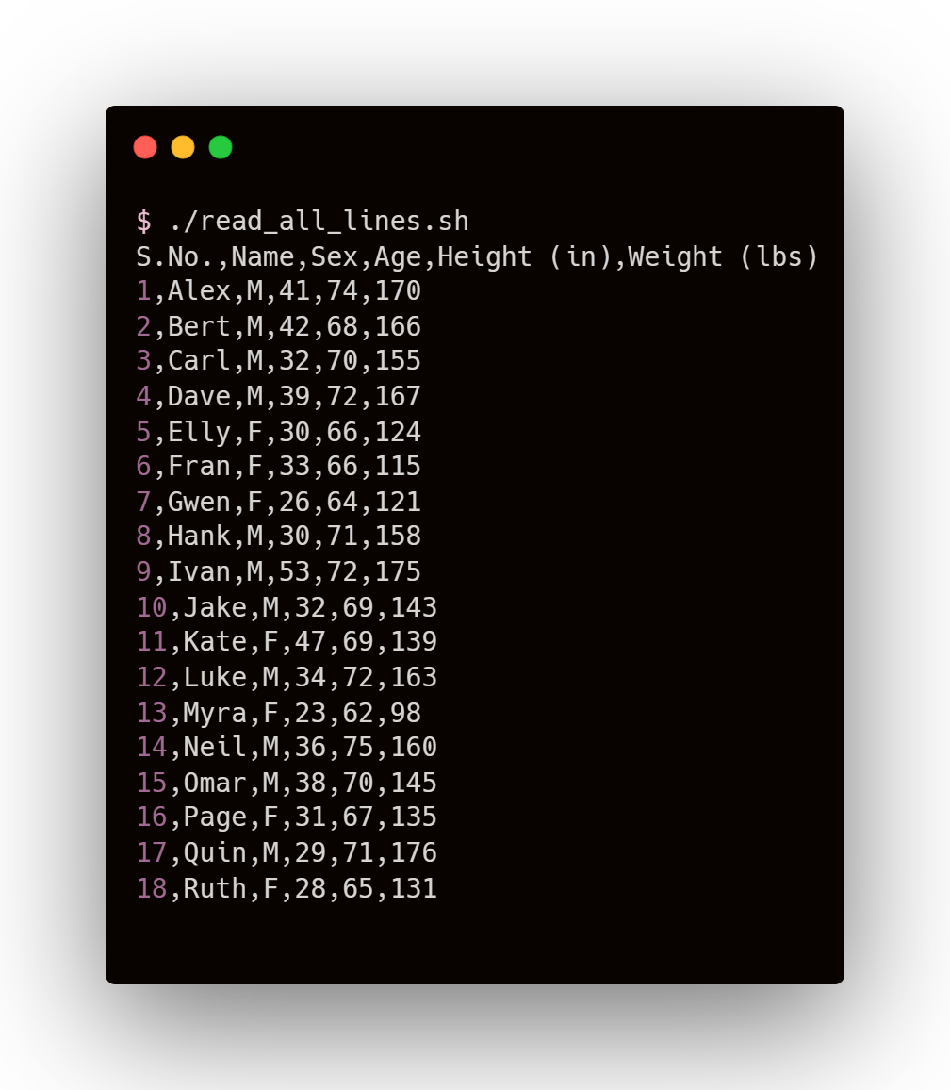
Reading All Lines

Slide 21
Reading All Lines
Input Redirection
Setting the desired file as input for the while-do-done loop

Slide 22
Reading All Lines
Reading from file
A line (ending with newline character) is stored in ‘line’ variable
Input Redirection
Setting the desired file as input for the while-do-done loop

Slide 23
Reading All Lines
COMMANDS
OUTPUT

Slide 24
How to ignore Header?

Slide 25
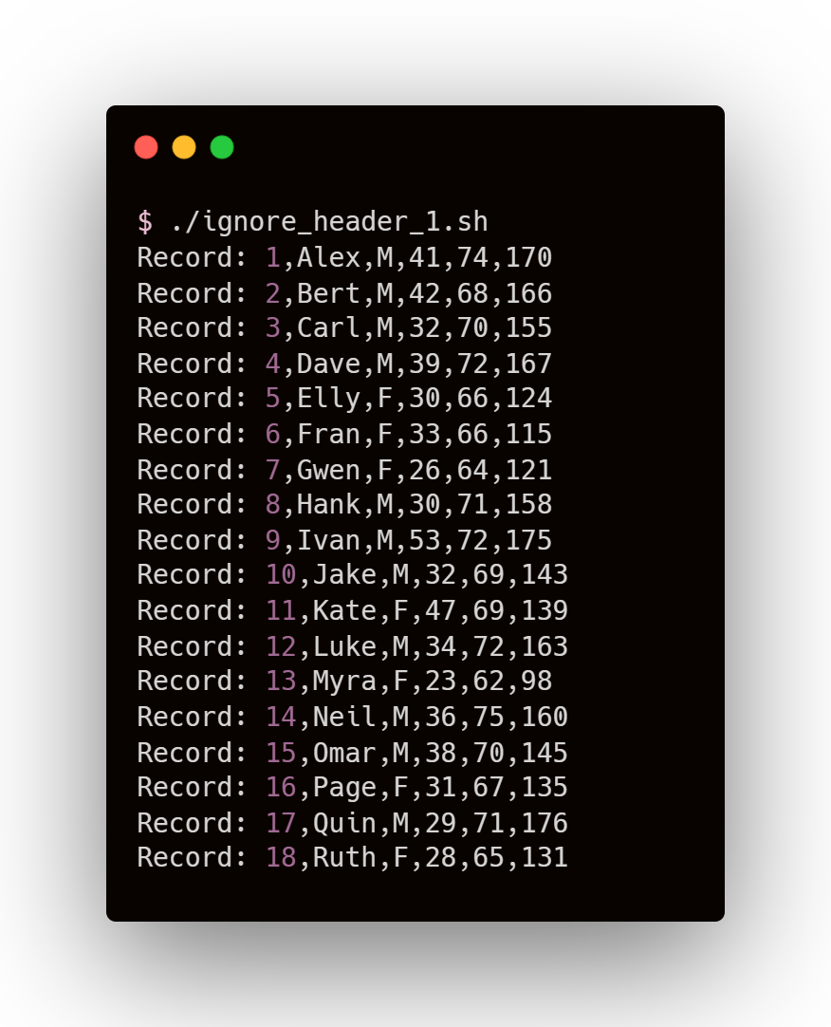
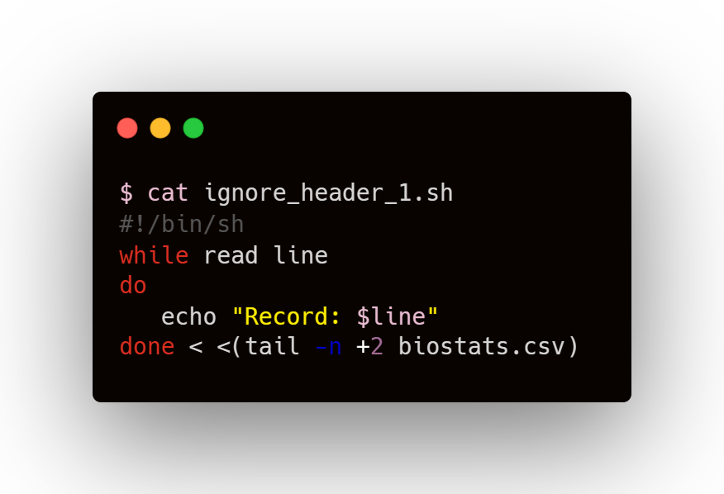
How to ignore Header?

Slide 26
How to ignore Header?
tail Command
tail filename
Returns last 10 lines of file
tail –n x filename
Returns last x lines of file
tail –n +x filename
Returns lines from xth line to end

Slide 27
How to ignore Header?
tail Command
tail filename
Returns last 10 lines of file
tail –n x filename
Returns last x lines of file
tail –n +x filename
Returns lines from xth line to end
Process Substitution
<(command) allows the command to appear as a file

Slide 28
How to ignore Header?
tail Command
tail filename
Returns last 10 lines of file
tail –n x filename
Returns last x lines of file
tail –n +x filename
Returns lines from xth line to end
No Space for process substitution
Space for redirection
Process Substitution
<(command) allows the command to appear as a file

Slide 29
How to ignore Header?
COMMANDS
OUTPUT

Slide 30
How to ignore Header?
Since we can skip reading header (the first row of file), there must be a similar way to read specific rows of the data...

Slide 31
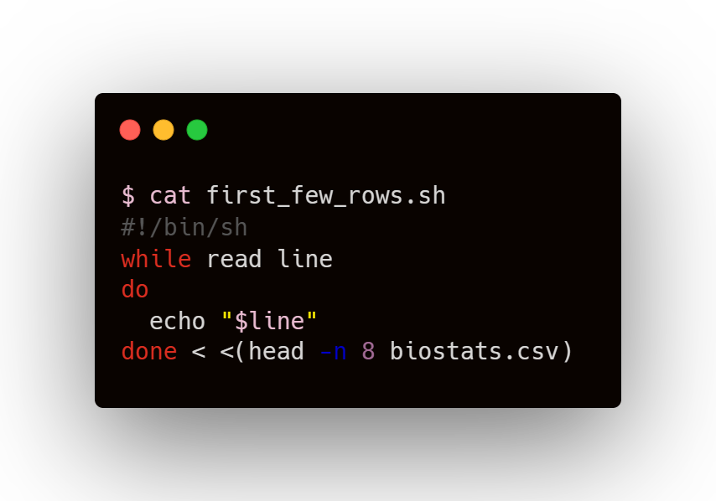
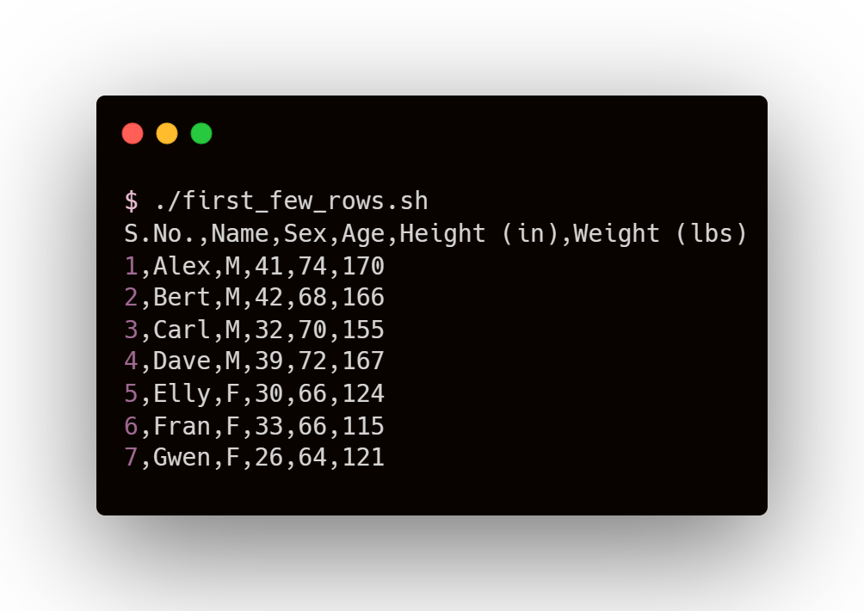
Read first few rows

Slide 32
Read first few rows
head Command
head filename
Returns first 10 lines of file
head –n x filename
Returns first x lines of file

Slide 33
Read first few rows
COMMANDS
OUTPUT

Slide 34
Read first few rows
We can use head command along with tail command to read rows in a specific range

Slide 35
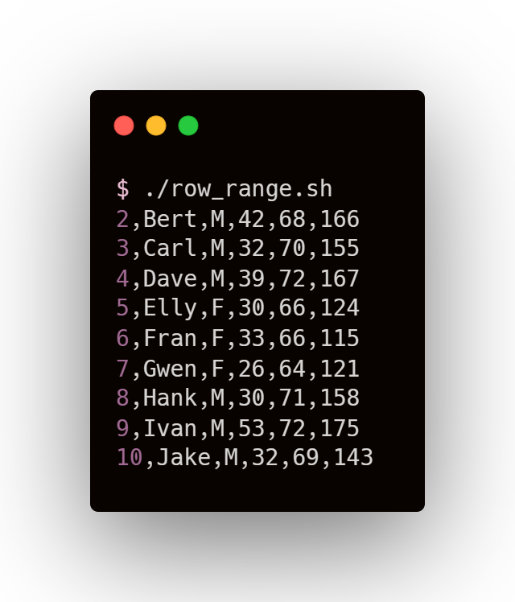
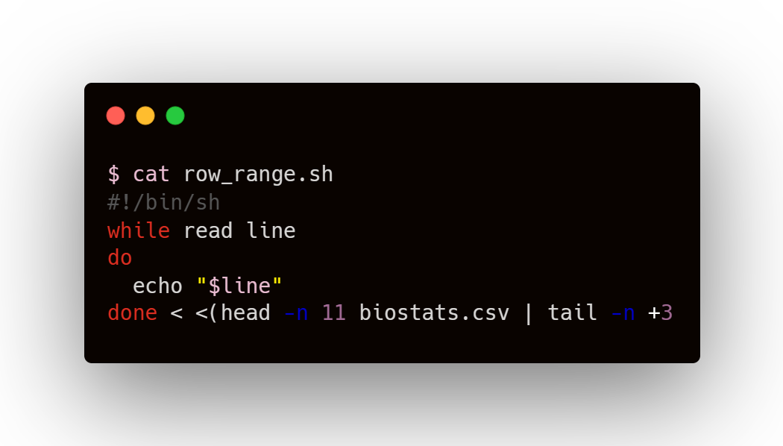
Read rows in a specific range

Slide 36
Read rows in a specific range
Piping
Output of first application (left of pipe ‘|’) becomes the input of second application (right of pipe)

Slide 37
Read rows in a specific range
Piping
Output of first application (left of pipe ‘|’) becomes the input of second application (right of pipe)
File
First x lines of file
yth to xth lines of file
head –n x
tail –n +y

Slide 38
Read rows in a specific range
COMMANDS
OUTPUT

Slide 39
Read rows in a specific range
To read columns, we make use of the fact that CSV files contain Comma Separated Values

Slide 40
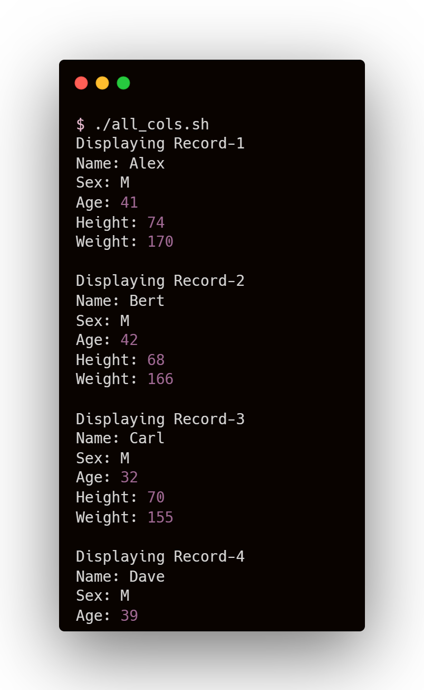
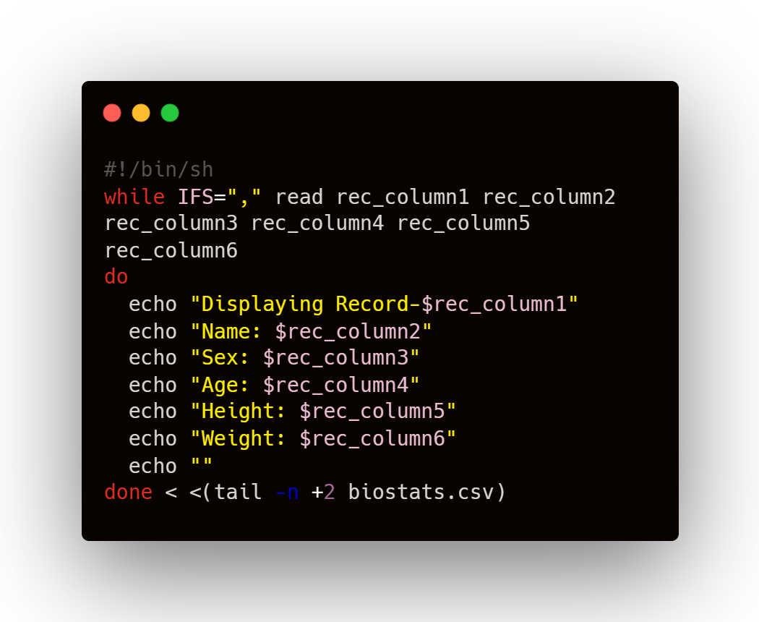
Read all columns

Slide 41
Read all columns
Internal Field Separator
Using IFS, line is divided into fields (tokens) and each token is assigned to a separate variable
For CSV, setting IFS=‘,’ is an obvious choice. For a line, each token is value from different column

Slide 42
Read all columns
COMMANDS
OUTPUT

Slide 43
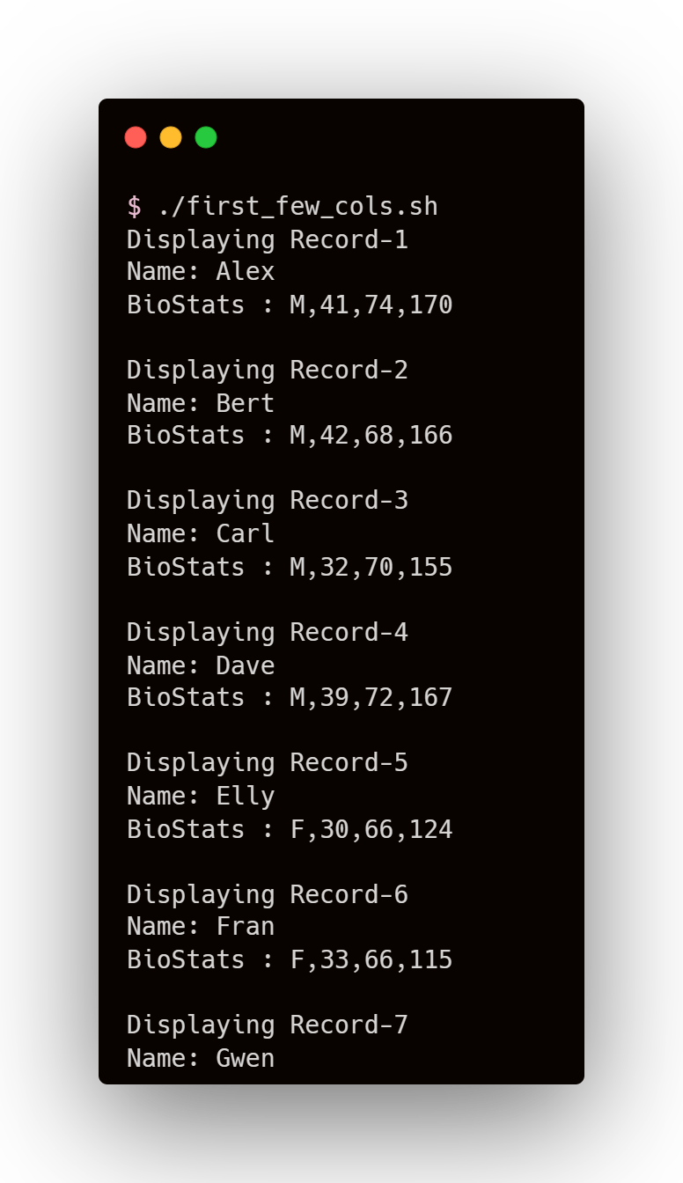
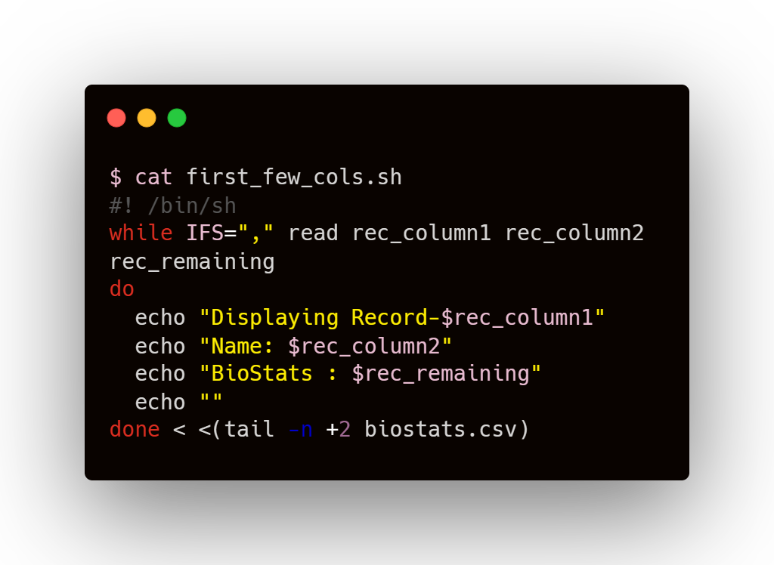
Read first few columns

Slide 44
Read first few columns
As number of variables defined is less than the number of columns, all remaining fields are assigned to the last variable
In fact, if there are (x) variables, the line is split (x-1) times, giving (x) tokens

Slide 45
Read first few columns
COMMANDS
OUTPUT

Slide 46
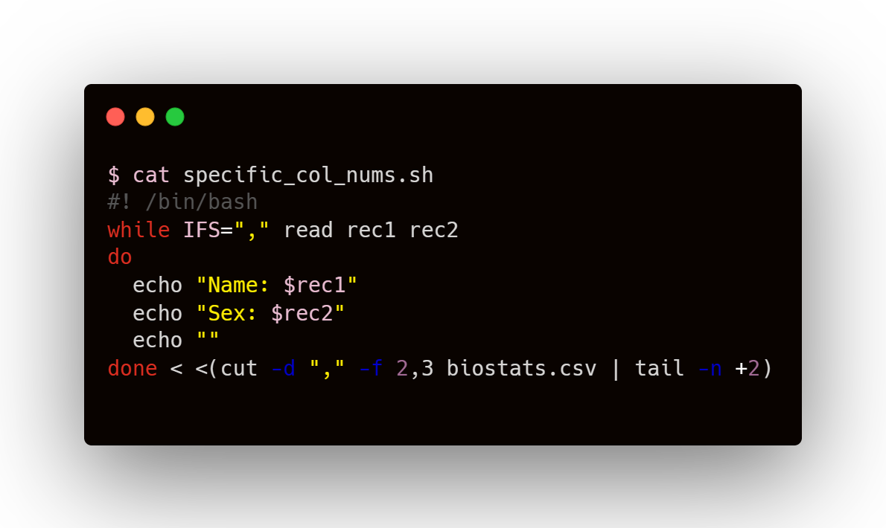
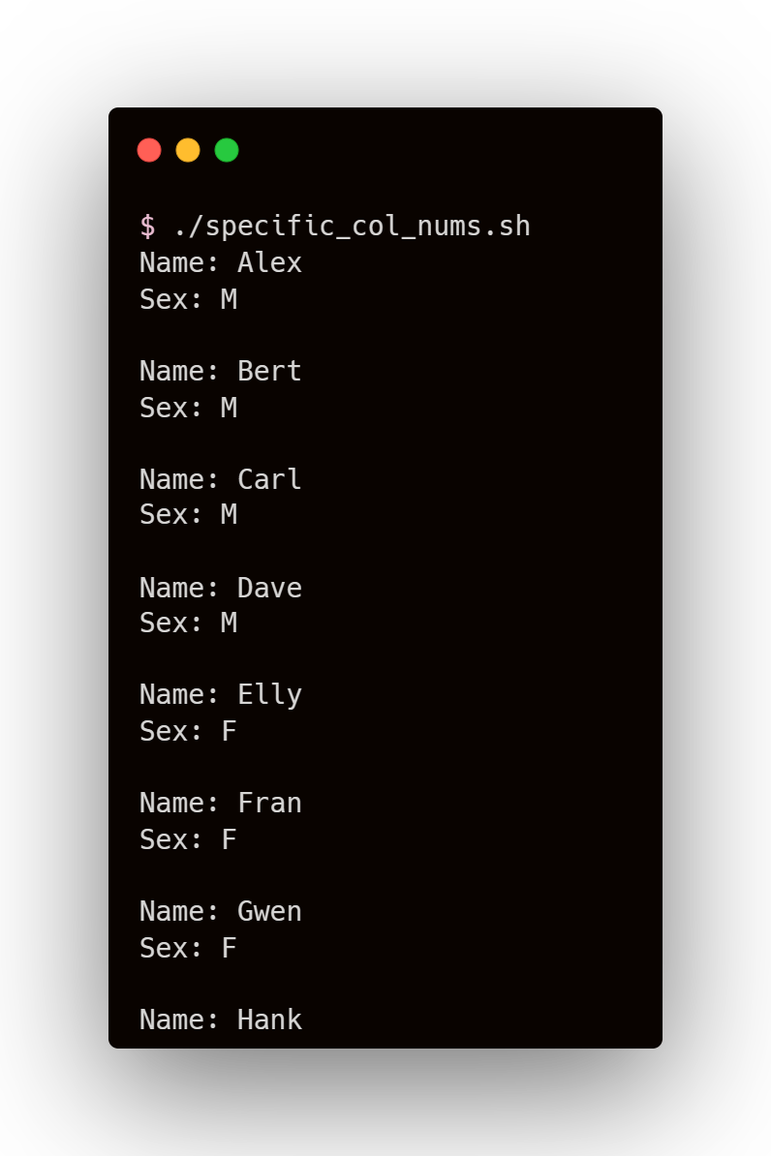
Read by specific column numbers

Slide 47
Read by specific column numbers
Cut command
for cutting sections from each line of file
column no’s
setting delimiter (character at which cutting is desired)
To slice data field by field

Slide 48
Read by specific column numbers
COMMANDS
OUTPUT

Slide 49
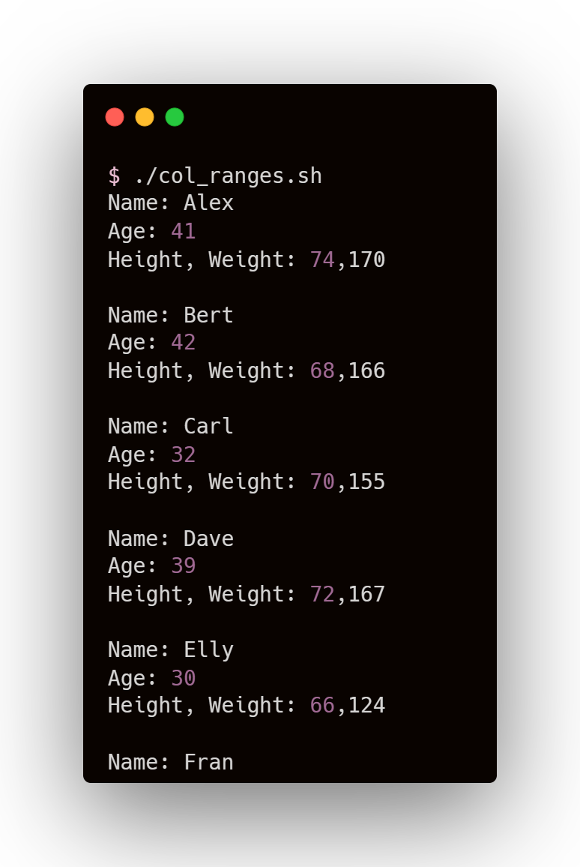
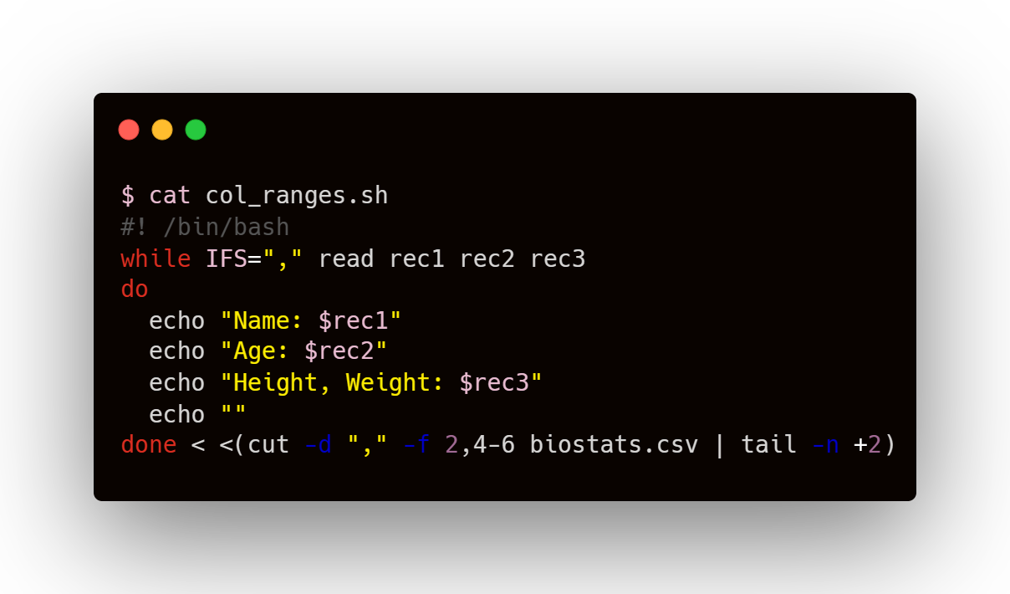
Read columns in a range

Slide 50
Read columns in a range
column numbers and column ranges separated by comma

Slide 51
Read columns in a range
Col 2
Col 4
Col 5
Col 6
rec1 rec2 rec3
column numbers and column ranges separated by comma

Slide 52
Read columns in a range
COMMANDS
OUTPUT

Slide 53
Read columns in a range
Generate a Report from a CSV file using all the knowledge we’ve gathered so far...

Slide 54
USER REPORT
OF A
CSV FILE

Slide 55
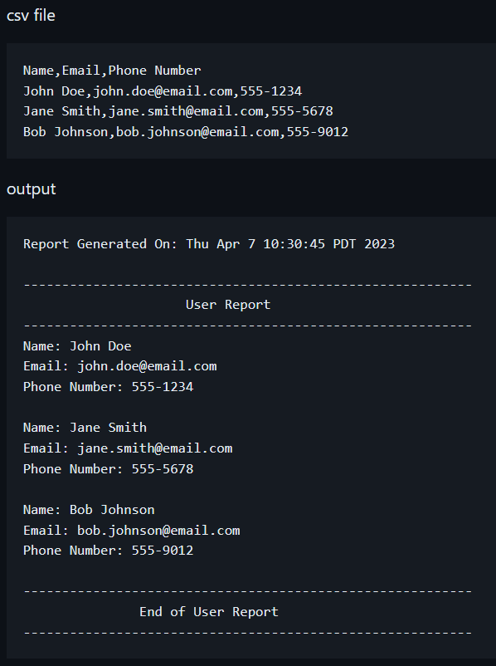
Format of
the Report

Slide 56
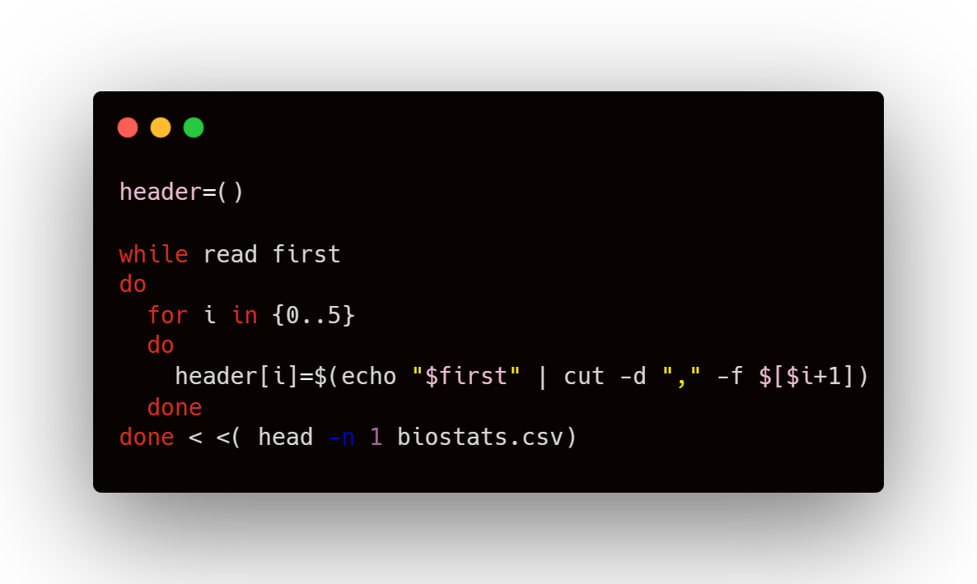
1. Storing headers in an array

Slide 57
1. Storing headers in an array
Only the first row of the file is read
“first” variable stores that line

Slide 58
1. Storing headers in an array
No. of columns = 6, so iterating from 0 to 5
Using cut command to get field-wise data of the string stored in “first” variable

Slide 59
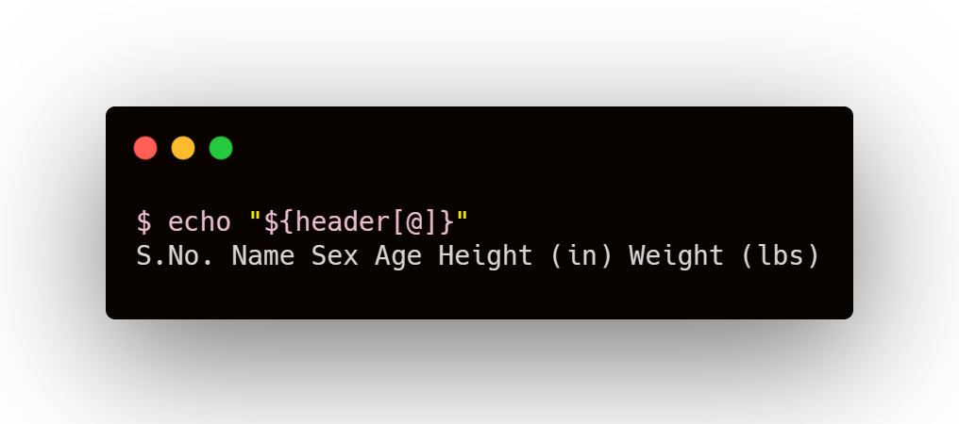
1. Storing headers in an array

Slide 60
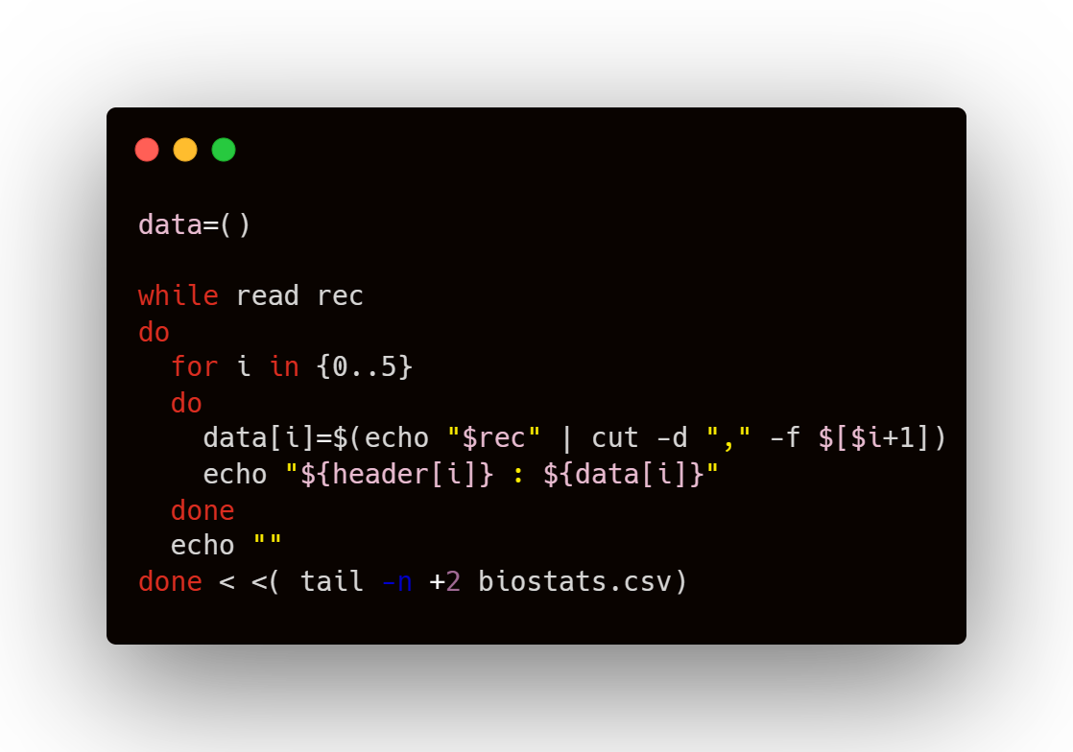
2. Printing data acc to the format

Slide 61
2. Printing data acc to the format
All lines (except header) are read
“rec” variable stores the line at every iteration

Slide 62
2. Printing data acc to the format
Using cut command to get field-wise value of line stored in “rec” variable
“data” array contains fields of nth line at nth iteration of outer while loop

Slide 63
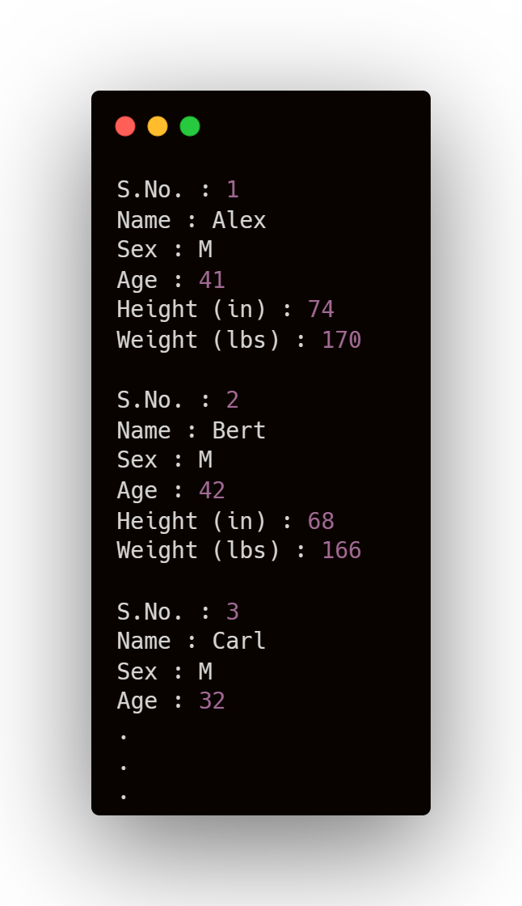
2. Printing data acc to the format

Slide 64
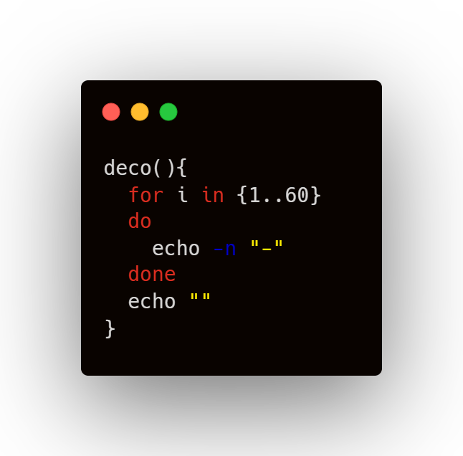
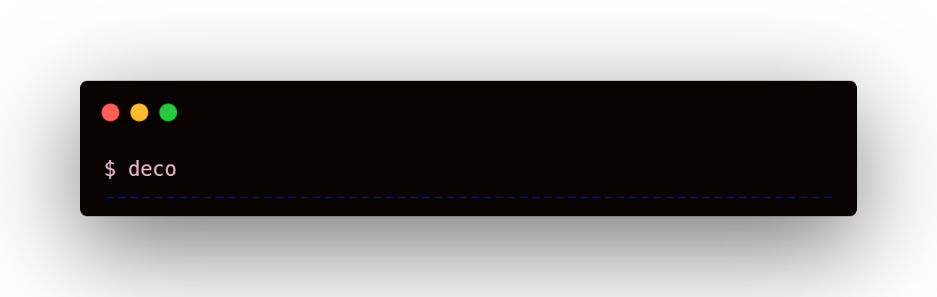
3. Decorating

Slide 65
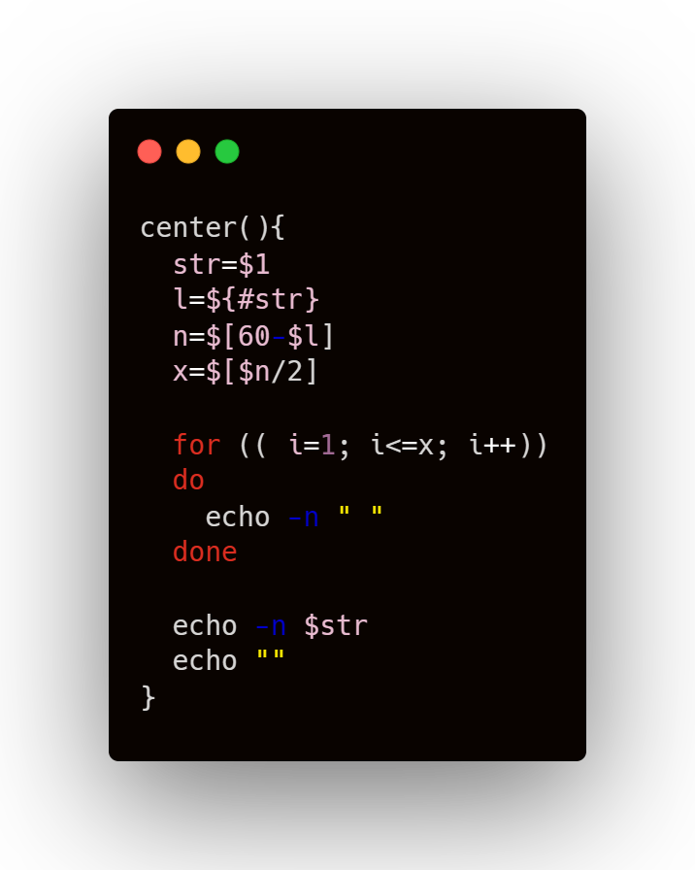
4. Center Justifying Text

